Slide 1
Mortgage Backed Securities
A Background
April 8, 2005
Compiled by:
Gurunandan, L&T Infotech

Slide 2

Table of Contents
Mortgages: Their significance in the economy
Mortgage Backed Securities (MBS)
Agency Pass-through
Structured Securities
Mortgage Terminology
Evolution and Market Sizing

Slide 3


Economic Function
Capital markets facilitate the flow of capital from savers to borrowers.
Capital
Savers
Borrowers
Capital Market

Slide 4



Economic Function: An Example
Mortgage
$
Bank
Banks offer home mortgages so that home buyers who are short of cash can borrow money to buy houses.
Home Buyer
$
Home
Ownership
Home Seller

Slide 5


Economic Function: An Example
Mortgage
Bank
$
Facilitated by
government agencies
such as the Federal National Mortgage Association, banks sell the mortgages to investors with surplus cash.
Govt.
Agency
$
Mortgage-
backed
securities
Investors

Slide 6
Economic Function: An Example
Mortgage
Mortgage
$
Bank
$
Cyclic Flow
of Capital
Govt.
Agency
Home Buyer
$
$
Home
Ownership
Mortgage-
backed
securities
Home Seller
Investors

Slide 7
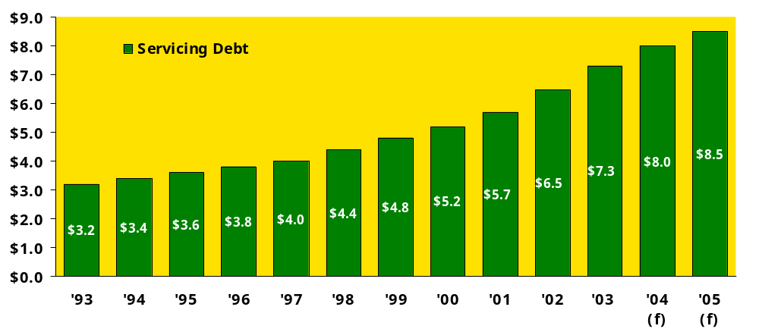
Mortgage Servicing Market Trends
In Trillions
8.5% CAGR
The total outstanding supply of MBS is projected to grow to be larger than that of the Treasury market in 2-3 years (CBOT Reference Guide to Mortgage Futures and Options)

Slide 8
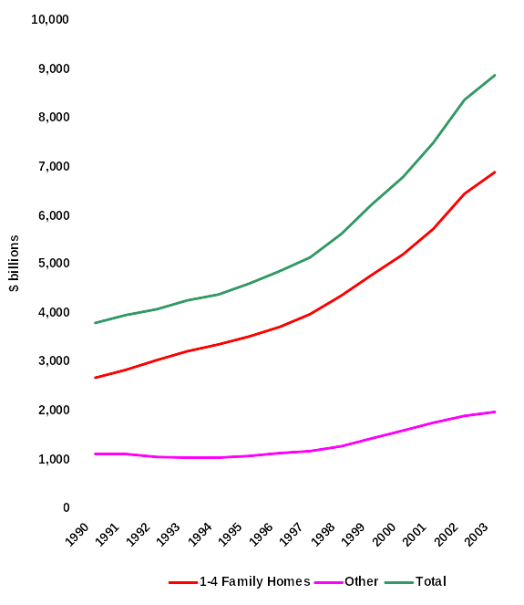
Continuing Growth in the Mortgage Market
Source: Board of Governors of the Federal Reserve, Flow of Funds Accounts, 2003 data through Q2

Slide 9
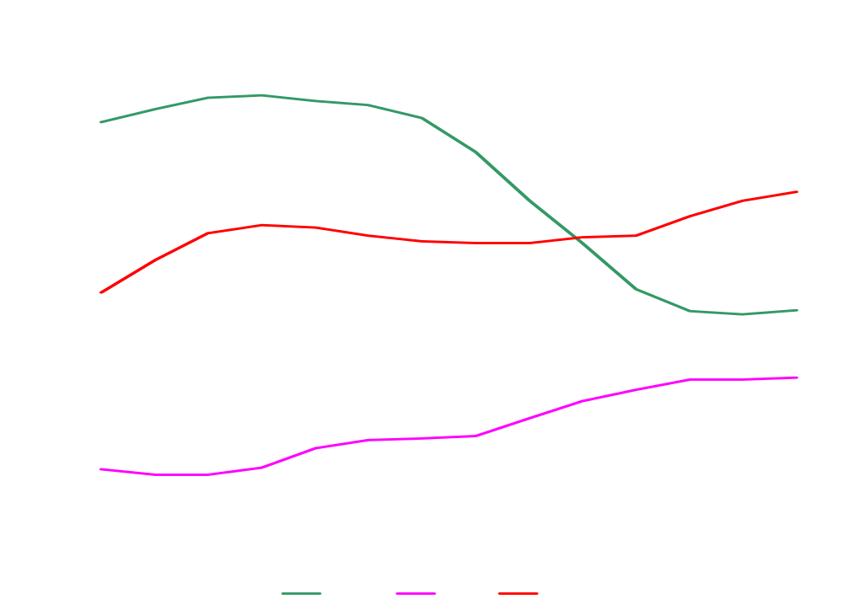
Continuing Growth in the Mortgage Market
Debt Securities Outstanding – Market Share
Source: Bond Market Association; 2003 data through Q2

Slide 10
Table of Contents
Mortgages: Their significance in the economy
Mortgage Backed Securities (MBS)
Agency Passthroughs
Structured Securities
Mortgage Terminology
Evolution and Market Sizing

Slide 11
Mortgage Backed Security
An investment instrument that represents ownership of an undivided interest in a group of mortgages. Principal and interest from the individual mortgages are used to pay investors' principal and interest on the MBS. Also known as "mortgage pass-through.“
When you invest in a mortgage backed security you are lending money to a homebuyer or business. An MBS is a way for a smaller regional bank to lend mortgages to its customers without having to worry if the customers have the assets to cover the loan. Instead, the bank acts as a middleman between the homebuyer and the investment markets.

Slide 12
Mortgage Backed Security
Definition (contd…)
Fixed income investment instrument that represents ownership of an undivided interest in a group of mortgages
Principal and interest from the individual mortgages are used to pay principal and interest on the MBS
Several types of mortgage securities issued within the U.S. marketplace -- including non-derivative and derivative products:
Non-Derivative Products
  Mortgage-Backed Bonds (MBB)
  Mortgage-Backed Securities (MBS)
  (also referred to as Pass-Through Securities)
  Derivative Products
  CMO’s, REMIC’s , etc

Slide 13
Why securitisation?
Securitisation is a financing technique to pool together and repackage illiquid financial assets into marketable instruments
  Mortgage Backed Securities (MBS) or Pass Through Certificates (PTCs) are issued against a pool of Home Loans
Legally, it involves sale of financial assets to a Special Purpose Vehicle (SPV), which are repackaged into Pass Through Certificates (PTCs)
Excellent vehicle for managing
  Cost of funds and profitability
  Asset-Liability mismatches
  Credit Risk

Slide 14
Securitization in Historical Perspective
Home mortgage market: funding shortfall in the late 1970s
Market response:
  Change tax laws: no double taxation on cash flow pass-throughs
  Modernized investment technology
  FNMA, Freddie Mac
Other asset-backed securities developed subsequently
  Auto loans
  Credit card receivables
  David Bowie albums

Slide 15
The Securitization Process
Participants
  Demanders of funds
    Homeowner / borrower of funds
    Bank / Loan originator
  Special purpose entity / trust
  Suppliers of funds
    Underwriter / investment bank
    Capital markets / investors
Some of the Benefits
  Liquidity
  Market values
  Lower cost

Slide 16
Mortgage-Backed Securities (MBSs)
Originated in response to mortgage funding shortfall
Mortgages are “securitized” by packaging mortgage loans and selling the cash flows as securities
The mortgage-backed securities represent ownership in the mortgages
Mortgages generally have an embedded option: to prepay the mortgage (in event of interest rates falling, mortgage-holder moving, etc.)

Slide 17
Mortgage-Backed Securities (cont.)
Investors receive the monthly mortgage payments (principal and/or interest) paid by the mortgage borrowers
With MBSs, the prepayment risk is transferred to the capital market investors
Investors are compensated for this risk by sufficiently high yields on the securities

Slide 18
U.S. Models for Mortgage Securitization
U.S. Market Segmentation
Government Financing
Conventional Financing
FHA
Loans
VA
Loans
Conforming
Loans
Non-Conforming
Loans
Subprime
Loans
“Alt” A Loans
Jumbo Loans
Government Conduit
Agency Conduit
Private Conduits
Ginnie Mae
Fannie Mae
Freddie Mac
FHLB
Commercial Banks
Insurance Companies
* Fannie Mae and Freddie Mac are also minor players in the government financing market segment
* Private Conduits may also issue securities based on conforming loans

Slide 19
Features and Benefits
Pass-Through Securities
Basic mortgage security issued within the U.S. market
Mortgage-backed securities involve:
  Pooling loans of one or more mortgage originators to form the underlying assets for the security
  Selling shares in the pool to investors to create pass-through security
Stream of cash flows received from the collateral is passed on to investors in an undivided manner
  Investors receive percentage of available funds on a monthly basis
  Payment based upon the percentage of ownership of the pool balance
Represents a true sale of assets for the issuer -- considered off-balance sheet financing

Slide 20
Features and Benefits (contd..)
Pass-Through Securities
$250,000
Interest and Scheduled Principal
Loan #1
Passthrough: $1 million par
Each loan: $250,000
Loan #2
$250,000
Interest and Scheduled Principal
Pooled Monthly Cashflow:
Interest
Scheduled Principal
Prepayments
$250,000
Interest and Scheduled Principal
Loan #3
Rule for distribution of cash flow: pro rata basis
$250,000
Interest and Scheduled Principal
Loan #4
Each loan is $250,000
Total Pool Amount: $1 Million

Slide 21
Pass-Through Securities
Cash Flow Characteristics
Cash flows generated by mortgage pool are passed on to the investor net the servicing spread
Pass-Through Coupon = Gross Mortgage Coupon - Servicing Spread
Servicing Spread = Servicing Fee + Guaranty Fee
$$
Monthly P&I Payment
$$
Monthly P&I Payment
$$
Monthly P&I Payment
Conduit or
Financial Guarantor
Capital
Market
Investor
Borrower
Issuer
Less
Servicing Fee
Less
Guaranty Fee
Cash flows include:
Scheduled interest
Scheduled principal repayments
Unscheduled payments
(including partial prepayments and prepayment of the entire outstanding balance of the loan)
Gross Mortgage Coupon (Note Rate)
Servicing Fee to Issuer (Servicer)
Mortgage Coupon to Conduit
Guaranty Fee (Conduit)
Pass-Through Coupon to Investor
7.00%
(.25%)
6.75%
(.25%)
6.50%

Slide 22
Pass-Through Securities
Cash Flow Characteristics
Servicing fee provides compensation to the issuer (or servicer) for assuming loan administration responsibilities including:
  Record maintenance and custody
  Cash management and accounting
  Collections and delinquency management
  Investor reporting (as required)
Servicing Fees in U.S. Market
Agency Conduits
( Fannie Mae & Freddie Mac )
Government Conduit
( Ginnie Mae )
Typically range between 25 and 37 basis points depending on loan and servicer characteristics
Higher servicing fee for adjustable rate loans due to increased complexity with cash management responsibilities
Negotiable with agency -- servicers with strong relationship and high servicing standards can receive reduced servicing fees
Typically range between 19 and 44 basis points depending on security type and lender preference

Slide 23
Pass-Through Securities
Cash Flow Characteristics
Guaranty fee is compensation provided to the financial guarantor for:
  100% guaranty of timely payment of principal and interest to investors
  Used to cover issuer credit risk in the event of default
  Assumption of some or all of the credit risk associated with underlying assets
Guaranty Fees in U.S. Market
Agency Conduits
( Fannie Mae & Freddie Mac )
Government Conduit
( Ginnie Mae )
Typically under 25 basis points
Negotiable with agency -- originators with high underwriting standards and clean delinquency history can typically negotiate a guaranty fee under 25 basis points
Often referred to as an “implicit government guaranty” given the government charter of the agencies
Typically around 6 basis points
Both the underlying loans and the securities are backed by the full faith and credit of the U.S. government

Slide 24
Pass-Through Securities
Additional Features
Issued as a single class with each investor having a pro-rata interest in the mortgage pool:
Investor receives principal and interest on a monthly basis in an amount equal to his proportionate share of the security
Often contains provisions for some type of credit support to protect the investors against delinquencies of payment and defaults on the underlying mortgage collateral
  Agency securities include financial guaranty of corporation (e.g. Fannie Mae, Freddie Mac) or government (e.g., Ginnie Mae)
  Private issuance securities include some form of internal or external credit enhancement
Example:
If 1,000 certificates are issued relative to a mortgage pool, each certificate would represent the right to 1/1000 of each payment of principal and interest on each mortgage in the pool.

Slide 25
Pass-Through Securities
Investor Perspective
Pooling of loans via MBS provides an effective vehicle for reducing risk over whole loan purchases:
  Rather than having full exposure to a few mortgages, investors have a lower exposure to many mortgages
  Allows investors to significantly decrease the credit risk of their portfolio
  Resulting securities are very generic in nature with an average life of about 10 years, AAA quality rating, and continuous monthly principal and interest cash flows
  Provides standardization of mortgages in large volumes
  Provides greater liquidity at a reduced cost
Investor considerations:
  Exposed to the full effects of prepayment and interest rate risk
  Unlikely to receive the same cash flow from their investment each month due to the potential for prepayments

Slide 26
Pass-Through Securities
Fannie Mae Experience
Fannie Mae standard MBS are direct pass-through securities - there is no special allocation of the cash flow from the underlying mortgages.
30 year, fixed rate pass-through security is:
  Most predominant Fannie Mae MBS product
  Most predominant product outstanding in capital markets
  Large volume of product in the market contributes to the ease and liquidity of secondary market trading of MBS
Special features of Fannie Mae MBS include:
  Can be purchased in unrestricted amounts by national banks, federally chartered credit unions, and federal savings and loan associations
  Counted as liquid assets for the Office of Thrift Supervision for federal Savings & Loan institutions
  Eligible for collateral as Federal Reserve and Federal Home Loan Bank advances
  Risk-based capital regulations of the bank and thrift regulators offer preferential treatment

Slide 27
Table of Contents
Mortgages: Their significance in the economy
Mortgage Backed Securities (MBS)
Agency Passthroughs
Structured Securities
Mortgage Terminology
Evolution and Market Sizing
Mortgages in India

Slide 28
What is an agency passthrough?
Agency passthroughs allow investors to receive cash flows (principal and interest, less servicing and guarantee fees) from a pool of single-family mortgages accumulated by one of the mortgage-related agencies (or government-sponsored entities).
The agency then provides a guarantee of payment to the investor.

Slide 29
Government sponsored entities (GSEs)
There are three mortgage agencies that are chartered by the U.S. government:
  Government National Mortgage Association (GNMA or Ginnie Mae),
  Fannie Mae (formerly known as the Federal National Mortgage Association or FNMA)
  Freddie Mac (formerly known as the Federal Home Loan Mortgage Corporation or FHLMC).
  The agencies stimulate the availability of low-cost mortgage funds with their implicit (Fannie Mae and Freddie Mac) or explicit (Ginnie Mae) government guarantee.
  Fannie Mae and Freddie Mac are quite active in the purchasing of conforming mortgage loans and the issuance of passthroughs.

Slide 30
How an agency MBS works
Consider an example of a Ginnie Mae (GNMA) passthrough.
  A mortgage lender such as Wells Fargo makes a mortgage loan commitment to a homebuyer to finance (or refinance) a mortgage loan.
  Wells Fargo would then obtain a guarantee from Ginnie Mae. Once the homebuyer settles (or closes) and the mortgage loan is created,
  Wells Fargo would include the mortgage in a pool (of similar mortgages) and deliver the mortgage pool to a securities dealer.
  The securities dealer will then sell mortgage-backed securities (MBS), which are guaranteed by Ginnie Mae to investors (Ginnie Mae guarantees the timely payment of interest and principal to investors).
  The sales of the securities are then reported to Ginnie Mae.
  Wells Fargo continues to service the mortgage by collecting monthly principal and interest payments from the borrower and forwarding the payments to Ginnie Mae.
  Ginnie Mae in turn forwards or passes through the payments to investors. Thus, a mortgage-backed security is often called a mortgage passthrough or mortgage passthrough certificate.

Slide 31
Adding more realism
In actuality, the agency MBS market relies on a network of lenders that includes not only commercial banks such as Wells Fargo, but savings and loan associations and mortgage bankers to originate the loans underlying the MBS.
Lenders submit bundles of mortgage loans to the agencies for securitization; as mentioned in the previous paragraph, the loans are bundled so that they are similar.
The agencies examine the loans so that they meet their credit quality guidelines; once the loans pass the examination, the loans are then included in a mortgage pool and finally converted into MBS.
Depending on the program, the resulting MBS will carry some combination of guaranteed timely payment of interest and principal to the investor.

Slide 32
Adding more realism
Each MBS pool carries a pass-through rate, or coupon, which is the interest rate passed on to the investor, usually on the 25th day after the end of the accrual period.
The pass-through rate is lower than the interest rate on the underlying mortgages in the pool.
This interest differential covers the guaranty fee paid to Fannie Mae, and the fee paid to the servicing institution for collecting payments from homeowners and performing other servicing functions.
The lender that delivers the mortgages for securitization or sold to another institution can retain servicing of the loans.

Slide 33
Key terms for agency MBS
WAC
WAM
Servicing fee

Slide 34
Trading agency MBS
Settlement and TBA
Settlement cash flows and security delivery
Delay of cash flows
Accrued interest
Delivery standards
  Variance
  Pools per million

Slide 35
Agency programs
Security
Guarantee
GINNIE MAE I
Full and timely payment of principal and interest, backed by the full
-
AND II
faith
-
and
credit guarantee of the U.S. government
-
PASSTHROUGHS
GINNIE
MAE
Full and timely payment of principal and interest, backed by the full
-
PLATINUM
faith
-
and
credit guarantee of the U.S. government
-
PASSTHROUGHS
FANNIE MAE
Full and timely payment of principal and interest guaranteed by Fannie
PASSTTHROUGHS
Mae.
FREDDIE MAC
Full and timely payment of interest and ultimate payment of principal
PARTICIPATION
guaranteed by Freddie Mac
CERTIFICATES
FREDDIE MAC
Full and timely payment of interest and scheduled principal guaranteed
GOLD
by
Freddie Mac
PARTICIAPTION
CERTIFICATES

Slide 36
Table of Contents
Mortgages: Their significance in the economy
Mortgage Backed Securities (MBS)
Agency Passthroughs
Structured Securities
Mortgage Terminology
Evolution and Market Sizing

Slide 37
Features and Benefits
Structured Securities
Multi-class bond issue that derives cash flows from underlying mortgages -- either pass-through securities (MBS) or pools of whole loans
Cash flows are carved up and distributed based upon principal and interest payment rules to various tranches of the transaction structure
Financially engineered to meet specific needs of various investors by redirecting cash flows to minimize certain risks:
  Prepayment risk redistributed into series of classes with short-, intermediate- and long- maturities
  Some classes have less interest rate sensitivity but lower yield to investors
  Other classes have substantially greater cash flow variability but offer investors higher returns
MBS
Class
A
Class
B
Class
C

Slide 38
Collateralized Mortgage Obligation (CMO)
  A mortgage-backed, investment-grade bond that separates mortgage pools into different maturity classes. Collateralized mortgage obligations (CMO) are backed by mortgage-backed securities with a fixed maturity. They can eliminate the risks associated with prepayment because each security is divided into maturity classes that are paid off in order. As a result, they yield less than other mortgage-backed securities. The maturity classes are called tranches, and they are differentiated by the type of return. A given tranch may receive interest, principal, or a combination of the two, and may include more complex stipulations. One negative aspect of collateralized mortgage obligations is the lower interest rates that compensate for the reduction in prepayment risk and increased predictability of payments. Also, collateralized mortgage obligations can be quite illiquid, which can increase the cost of buying and selling them.

Slide 39
Structured Securities
Following enactment of U.S. tax laws, structured securities became known as Real Estate Mortgage Investment Conduits (REMICs) - An investment-grade mortgage bond that separates mortgage pools into different maturity and risk classes. Multiple-class security backed by mortgage-backed securities or whole mortgage loans and formed as a trust, corporation, partnership, or segregated pool of assets that elects to be treated as a REMIC for federal tax purposes.
  Basically the same investment instrument as CMO
  Referred to as "derivative" products
  Distributes mortgage cash flows in an almost unlimited variety of ways
Derive cash from underlying mortgage collateral -- either passthroughs or pools of whole loans
  Process of using passthroughs as the underlying collateral referred to as "resecuritization".
Complexity of structures makes them suitable investments only for investors with knowledge of complex financial transactions -- typically, institutional investors who actively manage their mortgage-backed security investments
  Investor must have access to sophisticated analytical tools
  In order to purchase most structured securities, investor must be a sophisticated investor, and often must be a qualified institutional buyer (QUIB).

Slide 40
Analysis of Structured Security Classes
Types of Structured Securities
Class Principal Types:
  Sequential Pay (SEQ)
  Planned Amortization (PAC)
  Targeted Amortization (TAC)
  Companion or Support (SUP)
Class Interest Types:
  Floating Rate (FLT)
  Inverse Floating Rate (INV)
  Interest Only (IO)
  Principal Only (PO)
  Accrual (Z)

Slide 41
Table of Contents
Mortgages: Their significance in the economy
Mortgage Backed Securities (MBS)
Agency Passthroughs
Structured Securities
Mortgage Terminology
Evolution and Market Sizing

Slide 42
Mortgage Terminology
Par Value = Face Value = Principal Amount
Conforming mortgage loan: A mortgage loan which meets all requirements (size, type, and age) to be eligible for purchase or securitization by federal agencies.
Amortization: Repayment of mortgage debt with periodic payments of both principal and interest, calculated to retire the obligation at end of a fixed period of time; many patterns possible; amortization period may not match maturity of the loan
Amortization schedule: Table showing amounts of principal and interest due at payment dates and unpaid balance after each payment is made.
Negative amortization: Unpaid interest which is added to mortgage principal, where principal balance increases rather than decreases because mortgage payments do not cover full amount of interest due.

Slide 43
Mortgage Terminology
Coupon Rate: Rate used to calculate interest payments
  Fixed rate: coupon rate is fixed for life of mortgage
  Floating rate and floating index: rate is function of floating index; function can be complex
    Example: floating index = 6 month LIBOR
    Example: rate = LIBOR + 0.5 with floor and at each reset
Servicing fee: The fee earned by a servicer for administering a loan for an investor usually expressed as a percentage of the unpaid principal balance of the loan and deducted from the monthly mortgage payment.
Guaranty fee: Price for guaranteeing to an investor the timely payment of principal and interest from all the mortgages underlying a mortgage backed security; essentially covers the borrower credit risk

Slide 44
Mortgage Terminology
Reset schedules: Schedule for fixing floating rates
  Can be more frequent than payment schedule
  Fixing rate can be complex formula of index and can move up or down with index (“inverse floater”)
    Example: floating coupon paid semi-annually, fixing rate is geometric average of weekly 3-month LIBOR rates plus spread of 0.25, with cap of 6% and floor of 4%
Cash flow schedule: Schedule when payments are made
  Reflect both calculation period (period over which interest is accrued) and NBD rules
  Payment dates can differ from calculation period-end dates
    Example: period dates are semi-annual, but payment rolls to next good business day

Slide 45
Mortgage Terminology
Prepayment Option: Right of a borrower to prepay sum or all of the principal amount prior to maturity; most individual borrowers have this right with no penalty
Prepayment penalty/prepayment premium: a charge the mortgagor pays the mortgagee for the privilege to prepay the loan
Default Option: “Option” held by the borrower to cease making payments on the mortgage; modeled as an option because behaves like a “call”
A credit mortgages: mortgages which generally meet the credit underwriting guidelines of Fannie Mae, Freddie Mac, FHA,VA or major jumbo purchasers. Those who have credit ratings or other qualification deficiencies would be rated as B, C or D credit.

Slide 46
Mortgage Terminology
A General Guide to Credit Grades
Grade
Credit
Debt
Max
Mortgage
Revolve
Install
Score
Ratio
LTV
30
60
90
30
60
90
30
60
90
A+
670
36
95
0
0
0
2
0
0
1
0
0
A
660
45
95
1
0
0
3
1
0
2
0
0
B
620
50
85
2
1
0
4
2
1
3
1
0
C
580
55
75
4
2
1
6
5
2
5
4
1
D
550
60
70
5
3
2
8
8
4
7
6
2
E
520
65
60
6
4
3
10
10
6
10
8
3
Bankruptcy/Foreclosure
A+ None Allowed Within 10 years
A- Minimum 2 Years, Re-Established Credit
B Minimum 2 Years, Some Lates
C Minimum 1 Year
D Discharged
E Possible Current

Slide 47
Mortgage Terminology
Mortgages As Loan Investments
  Generally have low appeal because of the combination of long life, default option, refinancing (call) option and limited information about individual borrowers
  Valuation: refinance and default are responsive to conditions which make them hard to model
Mortgage pool
  Group of related financial instruments, such as mortgages, combined for resale to investors on a secondary market. Also called pool.
Pooling (Securitization) with Third Party Guarantees
  Provides diversification benefit, size benefit, credit risk reduction, all supporting trade in secondary markets

Slide 48
Mortgage Terminology
Securitization
Taking a pool of assets and creating a security that pays out the cash flows from the pool to security holders, according to a specified schedule
  Examples: passthroughs backed by mortgages; ABS backed by pool of student loans
May have third-party credit enhancements
Most basic is the Passthrough
  Timely payment of principal and interest, plus pass through of principal as received
  Delay days: time between receipt of the payments from servicers and payments to the investors
  Major risk is uncertain timing of prepayments (from refis, defaults)

Slide 49
Some MBS Terminology
Passthroughs Terms
Factor: A decimal value reflecting the proportion of the outstanding principal balance of a mortgage security, which changes over time, in relation to its original principal value. The Bond Buyer publishes the "Monthly Factor Report," which contains a list of factors for Ginnie Mae, Fannie Mae and Freddie Mac securities.
Weighted average coupon (WAC): An arithmetic mean of the coupon rate of the underlying mortgage loans or pools that serve as collateral for a security.
Weighted average loan age (WALA): The weighted average number of months since the date of note origination of the mortgages in a PC pool.
Weighted average maturity (WAM): An arithmetic mean of the remaining term to maturity of the underlying mortgage loans collateralize a security.

Slide 50
Some MBS Terminology
Passthroughs Terms
CPR: A method of expressing the prepayment rate for a mortgage pool that assumes a constant fraction of the remaining principal is prepaid each month or year. Specifically, the conditional prepayment rate is an annualized version of the Single Monthly Mortality (SMM). See also Single Monthly Mortality (SMM).
SMM = proportion of $1 mortgages outstanding at the beginning of the month that are prepaid during the month; that is
    [D(t-1)-D(t)]/D(t-1)
where: D(k) = [Pool factor(k)]/Bal(k)
    Pool factor = actual remaining principal balance per $1 of mortgage at the end of month k
    Bal(k) = remaining principal balance per $1 of mortgage at the end of month k, if there are no prepayments
    Then percent of initial balance that has prepaid is 1-D(k)

Slide 51
Some MBS Terminology
Passthroughs Terms
Then the constant SMM rate that is equal to the actual prepayments experienced is given by
SMM = 1-[D(t+n)/D(t)]^(1/n)
To express this annually:
  CPR = 1-(1-SMM)^12
PSA Standard
Assumes a prepay of 0.2% CPR for first month, with each month increasing by 0.2% until month 30, when the CPR is 6%; assumes 6% for all years remaining.
As a Percent of PSA
CPR = 6% * (x/100)*Min{1,n/30) for any n
CPRs change from month to month, based on a number of factors

Slide 52
Some MBS Terminology
Passthroughs-Factors Affecting Prepayment Speeds
  Current Coupon (ATM mortgage) & lagged current coupons
  Burnout (reflects path dependence)
  Seasonality (time of year)
  Seasoning (age of loans)
  State of origin
  Housing appreciation
  Other economic and demographic indicators

Slide 53
Pricing Mortgages/MBS
Prepayment option
  Refi incentive: function of cost to refinance and ratio of rate to current coupon; cash-out incentives
  Housing turnover: function of economic growth, housing activities; lifestyle issues
  Defaults & Partial prepays
  Seasonality and seasoning (burnout)
  Is an S-shaped curve centered on current coupon
  Estimated using historical information
  Is path-dependent

Slide 54
Mortgage Pricing
Core parameters
  Cashflow schedule (coupon, principal and dates received)
  Yield curve: discount rates derived from actual or inferred prices of zero coupon bonds; inverse is the discount function
  Terms and conditions of options
For bonds with fixed coupon, fixed amortization schedule and no options:
  P = C1/(1+z1) + C2/(1+z2)2 + C3/(1+z3) 3+ ... +CT/(1+zT)T
    Ct = cashflow at date t
    zt = zero coupon discount rate at date t

Slide 55
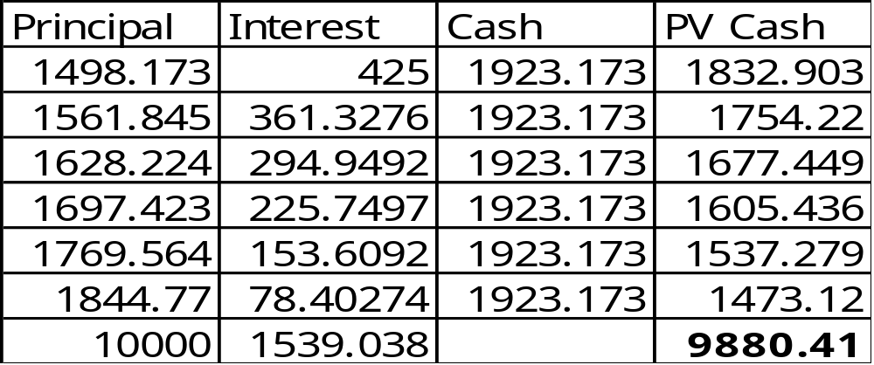
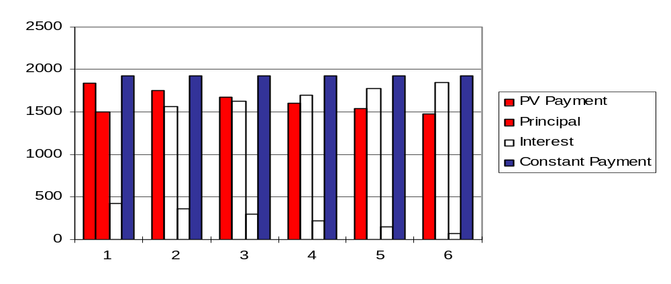
Mortgage Pricing
Cash flow table for a constant payment bond, scheduled payments

Slide 56
Concepts of Yield and Return
Yield to maturity
  Constant rate at which cashflows must be discounted to obtain the instrument’s present value (same as IRR)
  Equivalently, rate of return an investor will receive if a long term interest bearing security is held to maturity and the interest payments are reinvested at the discount rate
  Found by solving for Y in the following equation:
    P = C1/(1+Y) + C2/(1+Y)2 + C3/(1+Y)3 + ... +CT/(1+Y)T
    P = price; Ct= cashflow at time t
    Done by trial and error, involves an equation to the T power
  Does not take into account default risk; in event of default, cash flows will be less than promised

Slide 57
Concepts of Yield and Return
Yield to Call/Put
  YTM calculated to first call date or first put date
  principal amount replaced by scheduled redemption value at call/put date
  assumption is that bond called or put at first exercise date
Bond Equivalent Yield
  yield on an instrument converted to equivalent on a semi-annual, ACT/ACT (bond basis)
    Example: BEY for a mortgage is 2*[(1+Y/12)6 - 1],
    where Y = mortgage yield (monthly)

Slide 58
Concepts of Yield and Return
YTM and YTC Calculations
  10-year callable bond with bullet amortization pays 10% coupon, paid semi-annually; callable in 5 years at call price of 102, currently priced at $900
  YTM Calculation
    900 = 50 S1/(1+Y/2)t + 1000*(1+Y/2)20, t = 1,…,20
    Y = 5.8622
  YTC Calculation
    900 = 50 S1/(1+Y/2)t + 1020*(1+Y/2)10, t = 1,…,10
    Y = 6.541

Slide 59
Pricing Mortgages and MBS
Option-adjusted spread modeling
  Monte Carlo simulation of future interest rate paths, using Treasury or LIBOR (swap) curves
  Calculation of prepayment at each node, to get expected cash flows for each path; taking into account path dependence
  Discounting back using a spot curve
  Equate spot price sum of discounted cash flows using discounting curve plus OAS
  OAS are not comparable across securities
  Subject to model error in IR process, volatility assumptions, prepayment assumptions

Slide 60
Pricing Mortgages and MBS
Option-adjusted spread modeling
z(t,k) =simulated spot rate for month t on path k
PV(C(t,k) = C(t,k)/[1+z(t,k)+OAS]^(1/t)
  C(t,k) = cash flow in month t on path k
PV(Path(k)) = sum of PV(C(t,k))
Price = Sum of PV(Path(k))/K,
    where K = total number of paths
  OAS is the constant spread on all paths that makes the sum of the PVs equal to market price.

Slide 61
Pricing Mortgages and MBS
Questions to ask about models
  Is it a good fit to the historical data.
  Is it consistent with dealer PSA estimates.
  Is it consistent with dealer OAS figures.
  Do durations match dealer effective durations.
  Does it predicts bond cash flows accurately.
  Does it predict bond price changes accurately.

Slide 62
Pricing Mortgages and MBS
Yield spread over Treasury with same WAL
Yield spread over Treasury with same duration
OAS - Option-adjusted spread over the Treasury curve
Weighted Average Life (WAL)
Dollar Duration - Average price change for 100 bps Treasury curve shift
Dollar Convexity - Change in duration for 100 bps Treasury curve shift
Spread or OAS Duration - Change in price for 100 bps change in OAS
Embedded Option Cost - Cost in bps to hedge embedded options
Vega - Sensitivity to volatility
Prepay Sens - Price change for increase in prepayment forecasts

Slide 63
Pricing Mortgages and MBS
From the website: http://www.cbot.com/cbot/www/page/0,1398,14+371,00.html
The proposed CBOT® Mortgage futures and options contracts will track prices of conventional 30-year mortgage-backed securities issued by Fannie Mae and Freddie Mac. The new contracts are designed to be the right tools for today's mortgage market and will focus on mortgage coupon levels at which new issuance is heaviest and trading activity is busiest. The new contracts will help to increase liquidity in the mortgage securities market by giving mortgage originators, servicers, dealers, and investors new and more effective risk-management tools.
The price of this contract tracks an index of dealer prices for three current coupons in the TBA market, but explicitly uses the cheaper of Freddie Mac or Fannie Mae prices in each coupon. It settles 2 days before Notification Day in the TBA Delivery month. The contract settles in cash, which means no actual mortgage security is delivered. This adds liquidity.

Slide 64
Pricing Mortgages and MBS
From the website: http://www.cbot.com/cbot/www/page/0,1398,14+371,00.html
There are many uses, but the simplest example is this. A seller has loans in the pipeline that have not closed. Some of these loans may drop out (fall out). The seller is thus long in mortgages and wants to hedge. One hedge would be to sell forward to Freddie Mac through a Best Efforts contract. An alternative would be to sell the Mortgage futures. Thus any losses on the pipeline would be offset by gains on the sell side. To hedge the fallout the seller could use the options, which are likely to be much more liquid than the currently available OTC MBS options. Then the seller would sell to Freddie Mac only the loans that actually closed, and could have more flexibility on the timing of the sale.

Slide 65
Some References
http://www.spiresfin.com/market/reports/drms3/reporter.htm
http://www.aftgo.com/pm.html (commercial software)
http://www.servicing.com/miac/services/hedgeadvisory.htm#IPS (commercial site)
http://www.psa.com/publications/sales-iggse/calculating.htm
http://www.ljh.com/mort.htm (article on MBS arbitrage)
http://www.dfin.com/glossar2.htm#Mortgage Derivatives and Hybrid Terms

Slide 66
Table of Contents
Mortgages: Their significance in the economy
Mortgage Backed Securities (MBS)
Agency Passthroughs
Structured Securities
Mortgage Terminology
Evolution and Market Sizing

Slide 67
Interesting Fact
The total outstanding supply of MBS is projected to grow to be larger than that of the Treasury market in 2-3 years (CBOT Reference Guide to Mortgage Futures and Options)
“State of the Nation’s Housing”
Harvard Housing Center reported that U.S. households will increase 22.6% to 129 million in the next 20 years or 1.19 million new households per year
“It is clear that the underlying demographics will (drive) the housing market” - Nicolas Retsinas
Source: State of the Nations Housing report, Harvard Housing Center, June 2002.

Slide 68
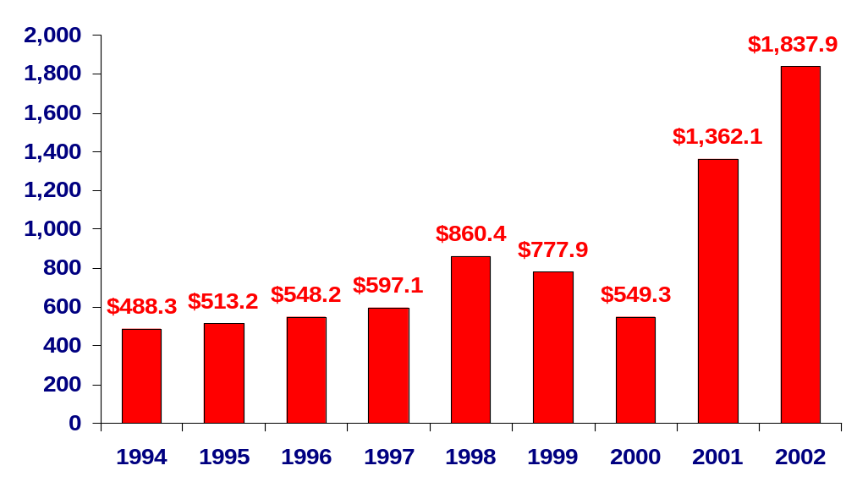
U.S. Mortgage Securitization Market
Evolution and Market Sizing
2002 MBS Market Share (in US$ billions)
Total MBS Issuance $ 1,838
Total Originations $ 2,526
Total MBS Outstanding $ 3,157
73%
Originations Funded Through MBS
Annual MBS Issuance
(in US$ billions)
Source: Inside MBS & ABS; 1/10/2003

Slide 69

U.S. Mortgage Securitization Market
Market Sizing
2002 MBS Market Share (in billions)
Total MBS Issuance: $ 1838
Total Originations: $ 2526
2002 Market Share Distribution by Issuer
(in US$ billions)
Private Conduits
23%
Fannie Mae
39%
Ginnie Mae
9%
Freddie Mac
29%
Source: Inside MBS & ABS, 1/10/2003

Slide 70
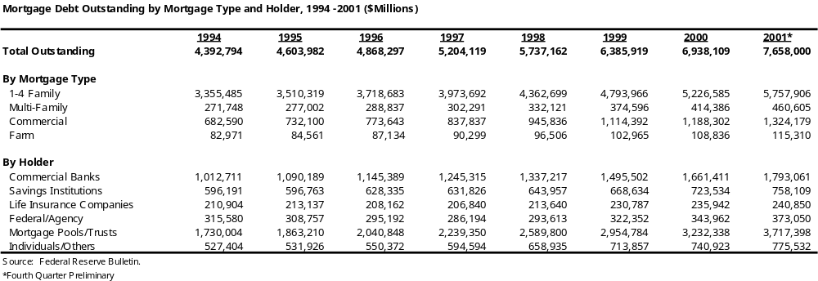
Mortgages outstanding

Slide 71
Mortgage issuance
Issuance of Agency Mortgage-Backed Securities, 1980-2002 ($Billions)
$1,200
$1,000
$800
($ Billions)
$600
$400
$200
$54 B
$85 B
$0
1980
1981
1982
1983
1984
1985
1986
1987
1988
1989
1990
1991
1992
1993
1994
1995
1996
1997
1998
1999
2000
2001
2002*
Source: Ginne Mae, Fannie Mae and Freddie Mac.
* as of September 30, 2002.

Slide 72
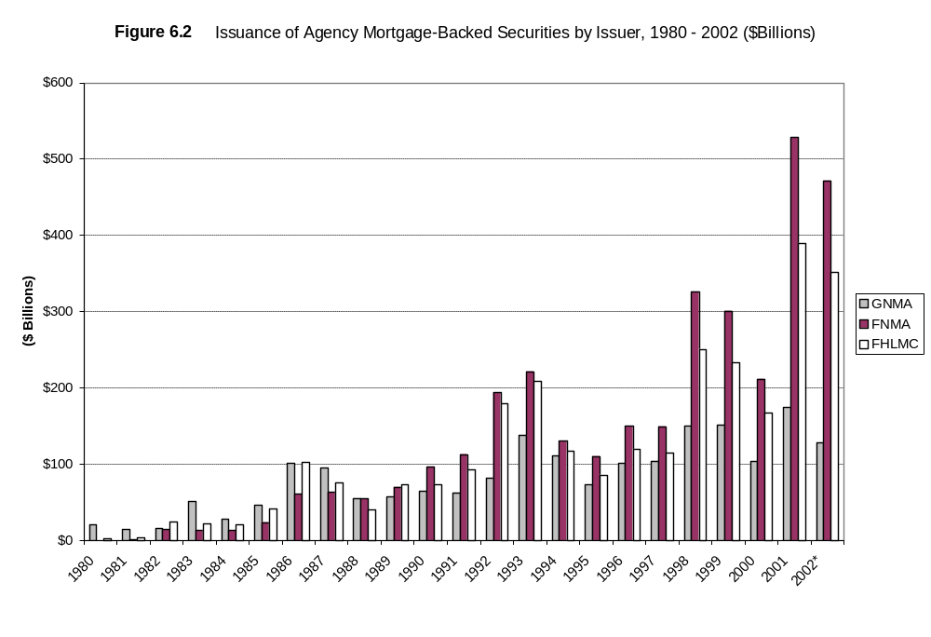
GNMA, FNMA and FHLMC Issuance

Slide 73
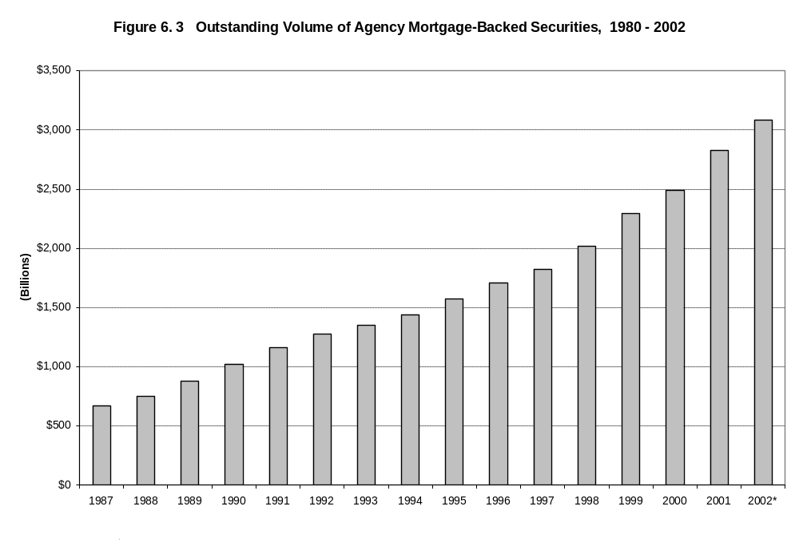
Agency MBS outstanding volume

Slide 74
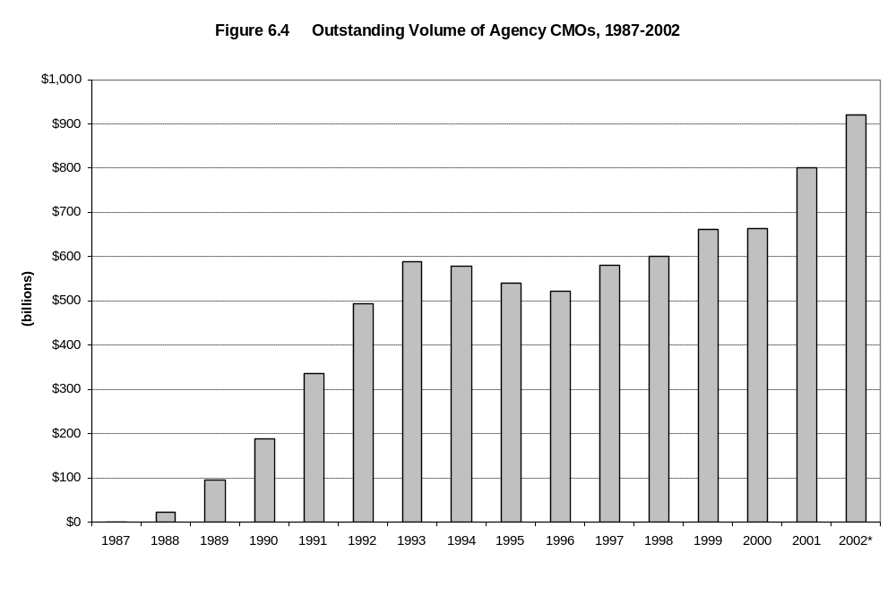
Agency CMO outstanding volume

